Slide 1
DS,ML and DL Premalatha T

Slide 2

WHO AM I?
LinkedIn: https://www.linkedin.com/in/latha-t-k-b21018128/
Data Science ,AIML
Data Analysis ,SQL,Pyspark
Data Visualization ,PowerBI,Tableau
Natural Language Processing (NLP)
Computer Vision
Generative AI,Prompt Engineering
BigData and Data Engineering

Slide 3
Agenda
What is ML,DL and AI
Steps in a ML Project
ML Techniques and Tools
DS Learning Path

Slide 4
Data?
Information and Noise(Insignificant information)
ML ,DS,AI-> Extract information(Exclude noise)

Slide 5
Types of Analytics
In today's data-driven world, information is king. But raw data itself isn't enough.
We need to analyze it to extract insights and make informed decisions

Slide 6
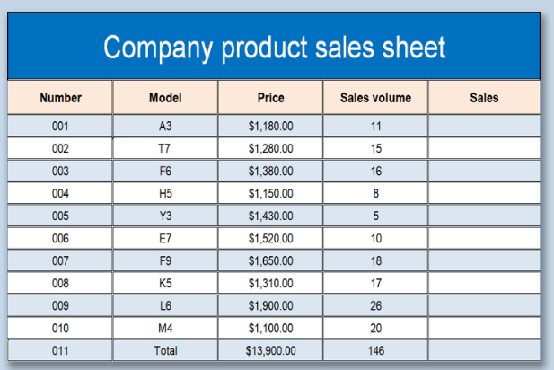
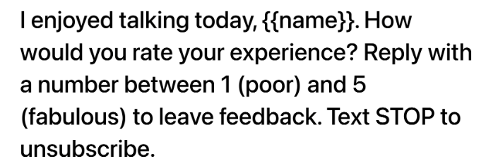

Slide 7
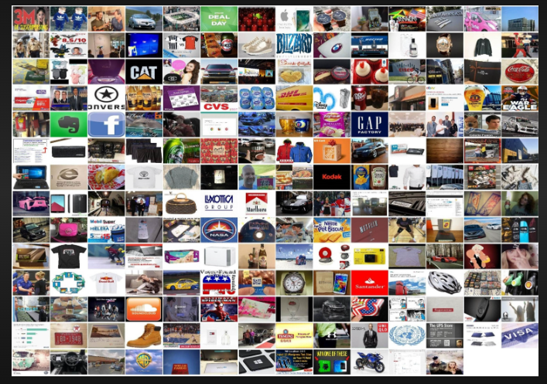
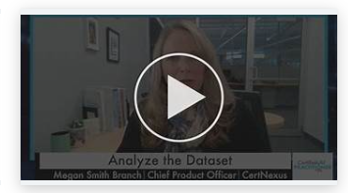
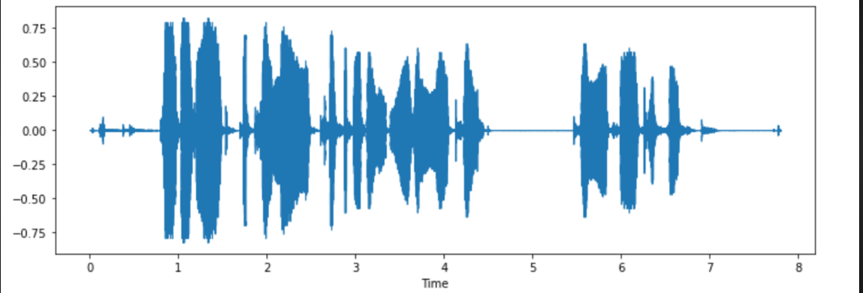

Slide 8






Slide 10
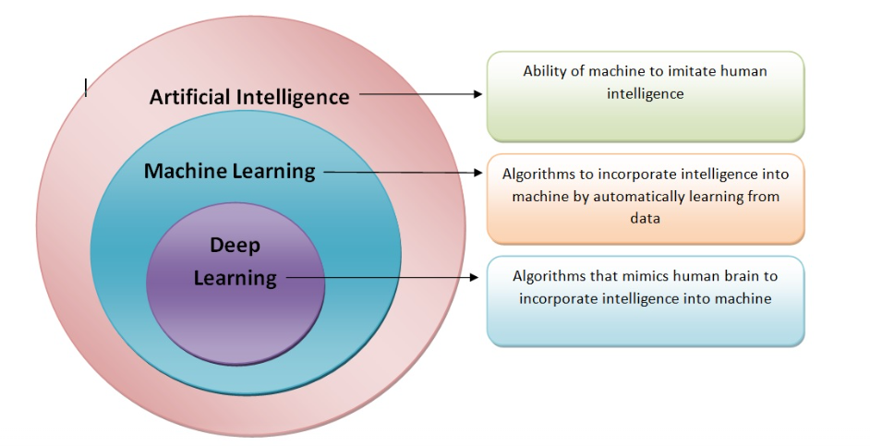

Slide 11
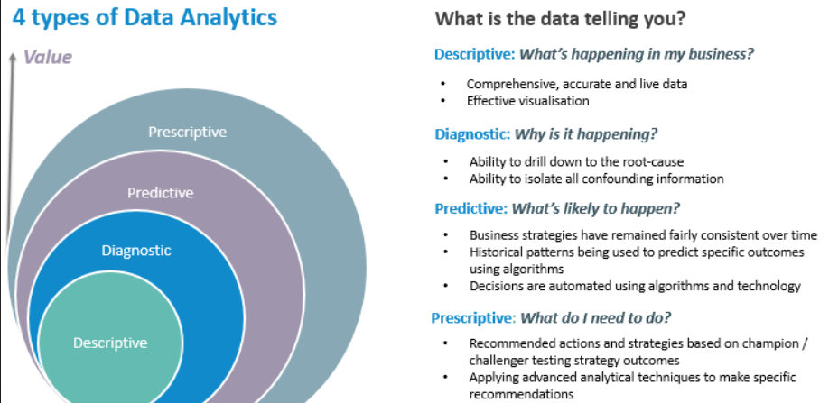

Slide 12
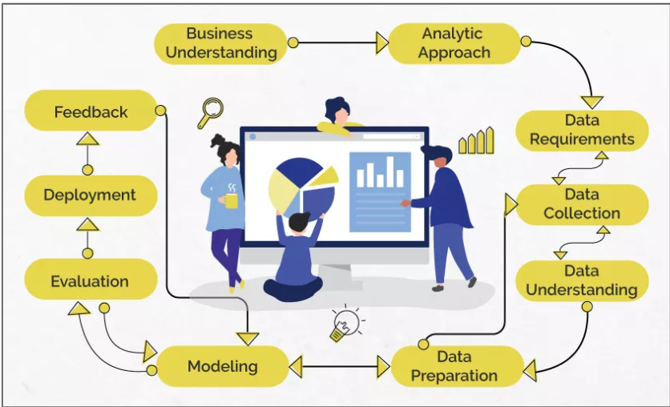
Data Science/Machine Learning

Slide 13
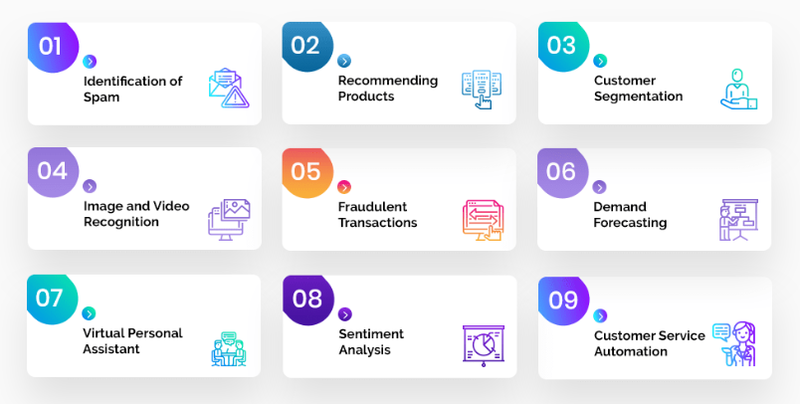
Problem Statement

Slide 14
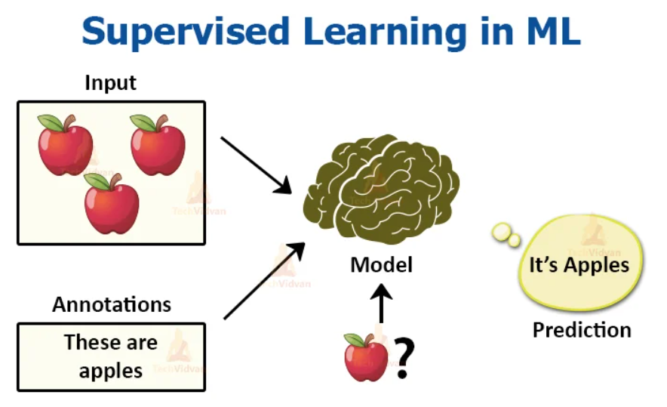
Analytic Approach

Slide 15
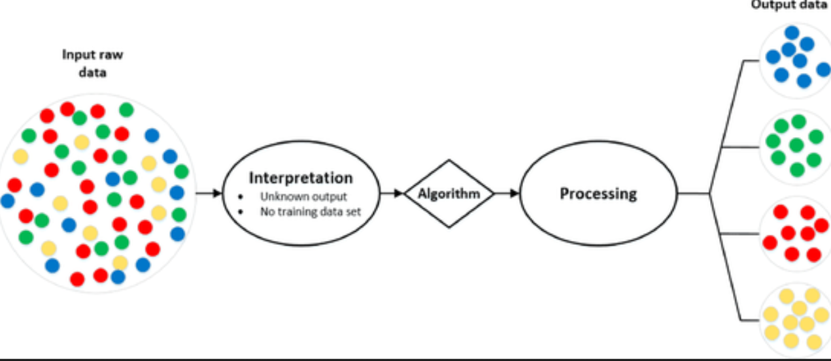
Analytic Approach

Slide 16
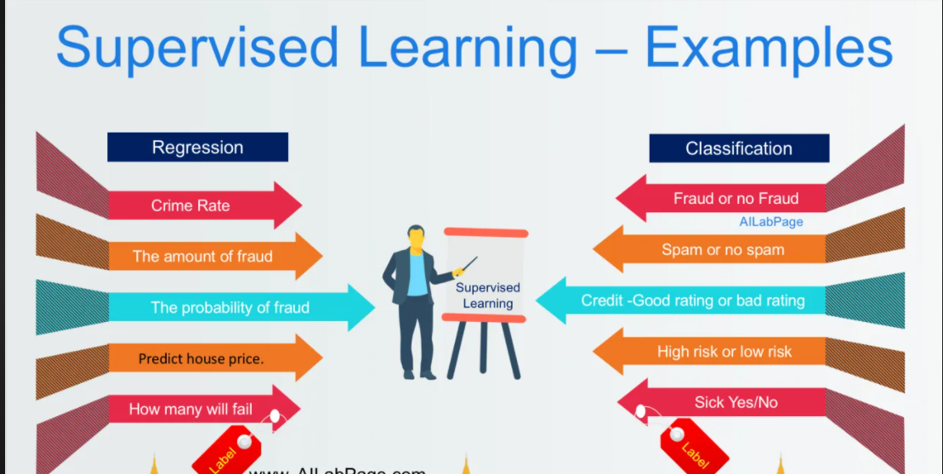
Supervised Learning

Slide 17
Machine Learning
Supervised Learning
Unsupervised Learning

Slide 18
Questions ????

Slide 19
















































